Slide 1
ML based detection of users anomaly activities
Yury Leonychev
ESG, Rakuten inc.
OWASP Night 9/3/2016
Notes:
Hi! My name is Yury. I’m a lead architect in Rakuten. Nice to meet you here.
Today I want to explain how to use machine learning methods to detect strange user behavior.
We will see that some mathematics algorithms are applicable for real tasks. And why its so simple and difficult in the same time to use machine learning.
I tried to keep my presentation maximally illustrative, so right now you can download additional utilities and check results.
I will answer a questions after presentation, don’t hesitate to ask your questions.

Slide 2
Agenda
Case study presentation
Workshop format
What | Where
IDE Continuum Analytics Anaconda | https://www.continuum.io/downloads
Python3+NumPy+SciPy+ScikitLearn | https://www.python.org/downloads/ http://www.scipy.org/install.html
Model Application | https://github.com/tracer0tong/buzzboard
Notes:
To illustrate my presentation I’ve made special model web application.
This is a Python 3.5 with additional libraries. It’s to bit complicated to install some of this to Windows machines (Linux and Mac users should have no problems). I recommend for developing purposes use a Anaconda IDE from Continuum Analytics.
This IDE contains all prerequisites and modules for ML implementation. We will use one of the most popular ML implementations, Scikit Learn.
If somebody want to reproduce results, you can download this tools and application from my GitHub repository.
Let’s move forward.

Slide 3
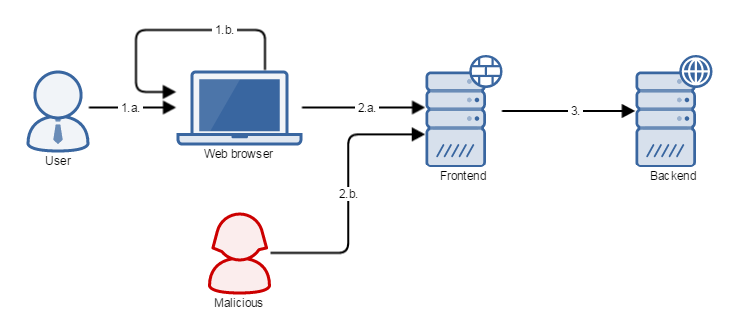
Abstract problem definition
Browser based activity
Normal user interacts with browser
Web application generated activity
HTTP request activity
Normal UA
Headless browser or script/bot
Frontend/Backend data exchange
Notes:
This is abstract problem definition for our web application. We decided to make anonymous message board and want to block spamers.
Basically this looks like binary classification task, but look at this technically.
We have a normal user, which basically will open our site in normal full stack User Agent (browser). And we have malicious user (attacker), which is usually a script or headless browser, but sometimes this is a hacked laptop or malicious module inside user browser.
Anyways we should define such model of our application. In real life this model should be more detailed of course.

Slide 4

Methodology (CRISP-DM)
https://en.wikipedia.org/wiki/Cross_Industry_Standard_Process_for_Data_Mining
https://en.wikipedia.org/wiki/Cross_Industry_Standard_Process_for_Data_Mining#/media/File:CRISP-DM_Process_Diagram.png By Kenneth Jensen License: CC BY-SA 3.0
Notes:
How to solve our task?
We shouldn’t invent bicycles, because there is perfect methodology for Data Mining. You can follow the link and read about it later.
Basically CRISP-DM defines lifecycle of data mining task.
It defines DM task as continuous process of different steps.
You should start from business understanding of task. Sometime you should minimize expenses, sometime maximize clicks on advertisement banners.
But metrics of success should be defined at the beginning of project. You should now how to measure your success.
On the second step you should understand, which sources of data are available. How much garbage in this data. Semantics of data and many other things like that.
Third step: you should prepare your data, create learning set. Probably you need to recover lost data or perform additional mapping of data with human support.
Next step is modeling: you should choose and train optimal model. Sounds simple, but no this is very difficult part.
You can change something in business understanding during Evaluation phase.
At the end you can deploy optimal model to production.
Everything changes, that’s why you model in most cases are optimal only temporary.

Slide 5
Model description
Business understanding – we want to classify “bad” and “good” users, where “bad” users couldn’t enter CAPTCHA, but “good” users – could.
Data understanding – HTTP requests and result of CAPTCHA checks.
Data preparation – collect requests, prove that this is full set. Get data from users and collect to database.
Create model. Define and tune settings for Decision Tree.
Calculate mistakes, validate model.
Deploy model to production.
Notes:
Let’s apply this methodology to our task.
We want to separate “bad” and “good” users. Main difference between this users is ability to input CAPTCHA. We decided that bad users cannot input reCaptcha.
We will extract all features from HTTP requests. Our target vector is CAPTCHA inputs.
To store requests (features) we will use Redis database.
To classify users we will chose not the best possible classification algorithm, but most illustrative and well interpretable.
That we will do next?
Calculate mistake, tune parameters and push our trained classifier to production.

Slide 6
Feature extraction
Direct | Indirect
Size of HTTP request | IP address reputation
Length of URI address | User reputation
User Agent | History based features
Amount of HTTP headers | Time based features
Response code/Response time | Business logic based features
… | …
Notes:
For web application you can define two different type of features.
First type is direct features, which could be extracted from HTTP request and responses. They are mostly intuitive, but you can construct something more complex if you want. In our model application we will use direct features only.
Second type is indirect features. For example IP address reputation. This features usually are more difficult to construct, and you need additional services and systems to extract them from raw data. But they are also very strong addition to learning set.

Slide 7
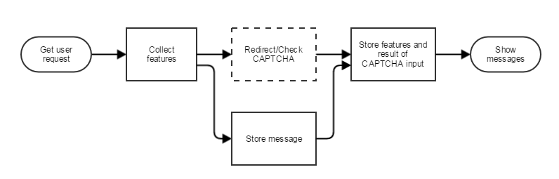
Application workflow
Notes:
*I will show first screen of web aaplication*
Look at other web application. As I mention before, this is a message board for anonymous users. But we still want to block spam activity here.
We want to construct learning set from user activity. Our web application written on Flask, so we can get data from “request” object. We will ask users to input CAPTCHA after every message.
This is a good schema to block spamers, but there are couple of problems.
CAPTCHA will annoy users.
If we will use CAPTCHAs every time, attackers starts to recognize them automatically.
Let’s improve our application and insert ML inside.

Slide 8
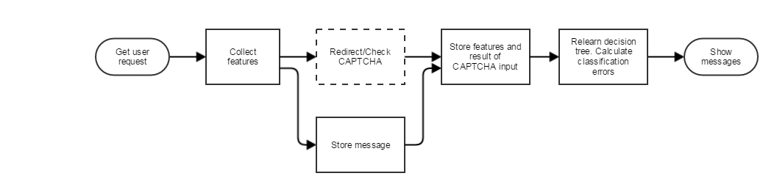
Application workflow (Learning Mode)
Notes:
We will choose one of the basic machine learning algorithms – Decision Tree. In our model application we will relearn classifier every time, when we get message from user.
This is not a very good schema for production, but we made a model application.
Let’s imagine that after project start evil spamers comes to your site and starts to spoil it with spam messages. Spamers couldn’t input CAPTCHA, so after short period of time we will got learning set.
And also we will get learned classifier. Look at “ML” page of our application.
Machine learning algorithm chose “UALengthFeature” to construct rule. And classifier can predict next event score with 100% accuracy. That’s perfect.

Slide 9
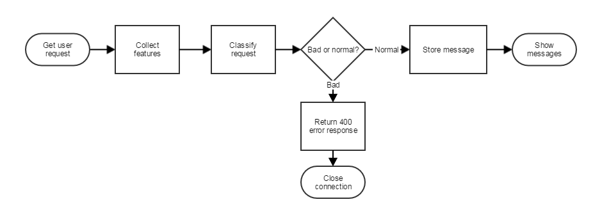
Application workflow (Strict Mode)
Notes:
Let’s give our application ability to use trained classifier for predict spam messages and block them.
We will send to malicious users 400 HTTP error code. After enabling “Strict mode” normal users can send messages without CAPTCHA. Malicious user will receive HTTP error.
That happens if attacker will use normal User Agent string? And will send more spam to us.
You can see that ML algorithm automatically chose a new classification feature. Amount of HTTP headers.
But that happens if attacker will be more smarter? Normal UA and huge amount of HTTP headers? ML will solve this problem for us as combination of different rules.

Slide 10
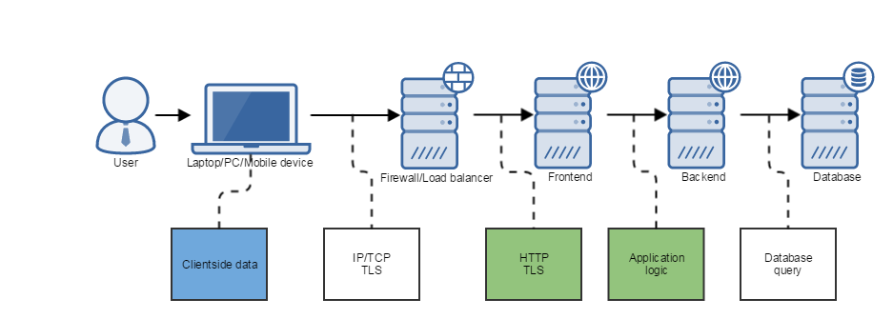
Decomposition
Notes:
If I mention before we made model application, but that we should do for real production environment?
One of the good ideas is to decompose your difficult task to different layers. If you want to try to build one classifier for all available features this is probably huge mistake.
Basically many different kinds of users activity can be collected and analyzed separately. Sometime it’s better to use heuristic rules or very simple classifiers to block extremely strange requests on frontends or firewalls, than pass all of them to backend.
Speed and even size of classifier depends on amount of features, which you will use. Some of this features are heavy for extraction and calculation. It can be expensive from performance point of view to calculate all this features for every event.

Slide 11




Offline computations
Offline with Hadoop, Spark (MLlib), Elasticsearch
Realtime with Spark (Streams and MLlib), Kafka
Same technologies available in AWS and Azure
Notes:
How to train classifier? In our model application we have only 5 features and less than 30 events. You shouldn’t fit classifier in production this way. Much better to use special high scalable and powerful tools. Such as Apache Storm, Spark, Hadoop, Kafka.
Apache Spark has special Mllib, which contains many of well know ML algorithms and methods. For Storm you can just create special “bolts” with ML algorithms. Storm also applicable for real time processing of events flow.
Hadoop and Kafka – high performance computational storage and transport.

Slide 12
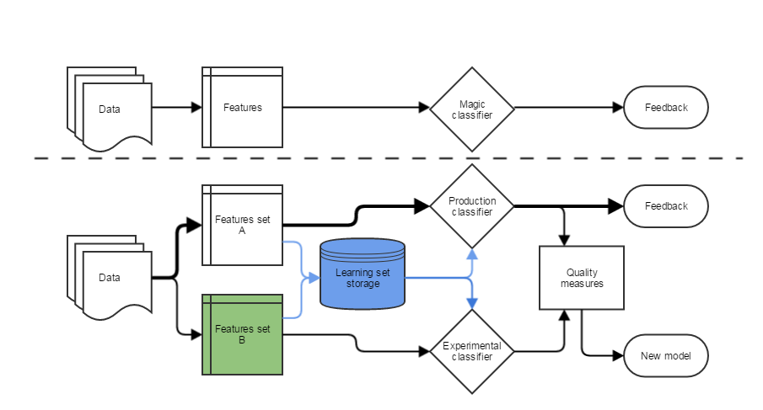
Continuous experiment
Notes:
Smooth integration to production environment needs more flexible implementation of ML.
There are different difficulties in machine learning process. In our model application we use a Redis database to store learning set. This is because impossible to create one classifier and use it forever.
Features can be changed, business requirements can be change. For example if you want to add new feature column to feature set, of course you can drop all data and start calculations from scratch, but better to store learning set or different learning sets to have ability for switching from one to another.
Also you should have ability to perform experiments, because all ML algorithms need some parameters tuning. That’s why you should be able to compare different classifiers, before changing them into production.

Slide 13
Knowledge matters!
You should understand what are you doing!
Is it normal to have 1.0 accuracy?
Could we measure Mean Squared Error for our model application?
Have we already chose correct algorithm and parameters?
This is correct feature?
METHODS = ['GET', 'POST', 'PUT', 'DELETE', 'OPTIONS', 'HEAD']
def MethodFeature(request):
return METHODS.index(request.method)
Notes:
You can ask me: if it’s so simple why we couldn’t apply ML immediately everywhere?
Problem that you should have understanding of mathematical internals of this algorithms. To illustrate this I specially made some mistakes in model application.
Just ask yourself:
Is it ok to get 100% accuracy? – No. For real life it means that you have very poor learning set.
Is it ok to use Mean Squared Error as measure of model quality in our case? – No. Because this is not a regression task.
Did we choose right algorithm and features? No. Decision tree – not very cool algorithm.
How about features? MeathodFeature is incorrect at all. We use array index as feature value, but how we can compare POST and HEAD HTTP requests methods?

Slide 14
Conclusion
Use a decomposition (different levels of classification)
Use flexible features collection
Prefer offline computations
Give yourself field for experiments
Don’t forget ML integration – continuous process
Get knowledges about ML
Notes:
Finally to summarize my presentation I want briefly remind all my suggestions.
--slide content—

Slide 15
Questions?
Yury Leonychev
ESG, Rakuten inc.
OWASP Night 9/3/2016
Yury.Leonychev@Rakuten.com
Notes:
Thank you!
ありがとうございます。
I glad to hear your questions.

